Slide 1
File Management from CLI

Slide 2
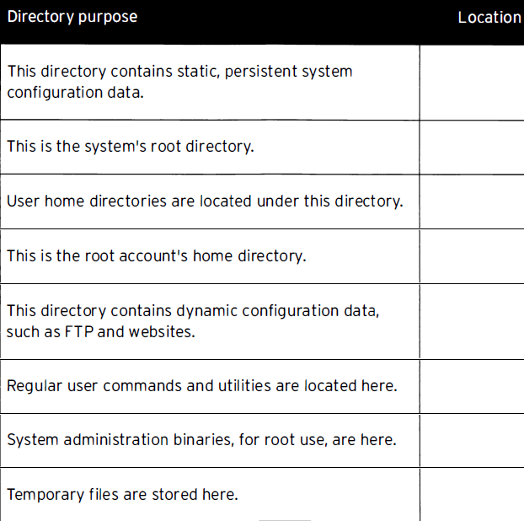
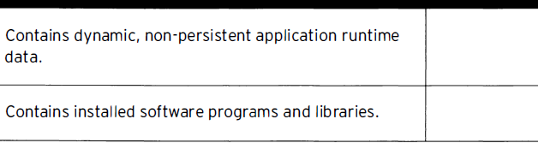
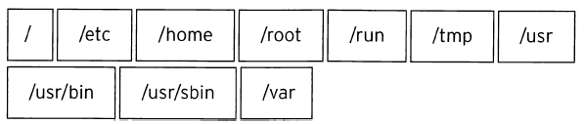
Quiz

Slide 3
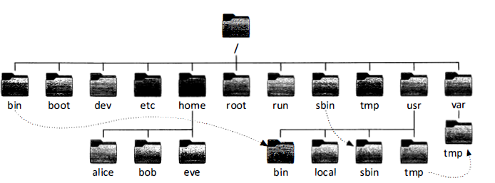
File System Hierarchy
All files on a Linux system are stored on file systems which are organized into a single inverted tree of directories, known as a file sys tem hierarchy.

Slide 4
The directory / is the root directory at the top of the file system hierarchy.
Subdirectories of / are used for standardized purposes to organize files by type and purpose. This makes it easier to find files.
The following terms are encountered in describing file system directory contents:
  static is content that remains unchanged until explicitly edited or reconfigured.
  dynamic or variable is content typically modified or appended by active processes.
  persistent is content, particularly configuration settings, that remain after a reboot.
  runtime is process- or system-specific content or attributes cleared during reboot.

Slide 5
Why File System Hierarchy is important..?
Basic Security
Categorizing Sharable and UN-sharable files in different buckets
Organizing application files as per the FHS complaint
Which gives more flexibility for the developers to write or develop programs
Easy to manage Operating system for Administrators

Slide 6
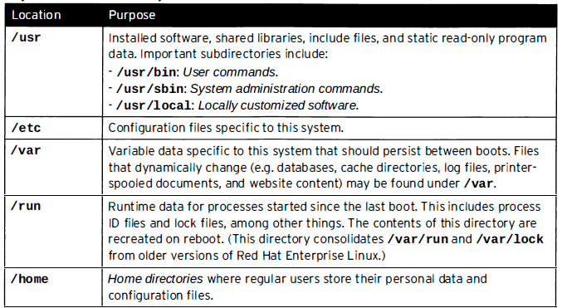

Slide 7
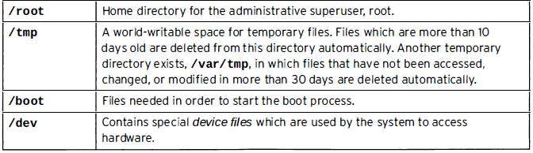

Slide 8
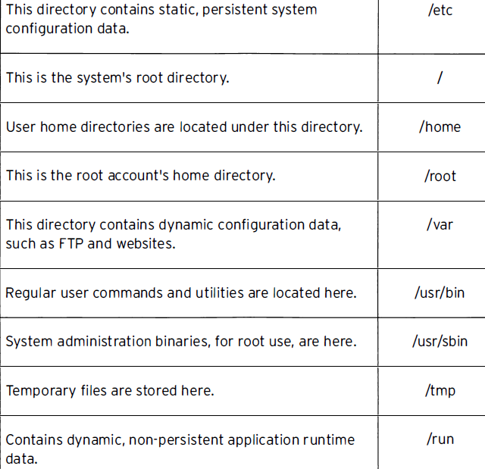


Slide 9
Absolute Vs Relative Path
An absolute path is a fully qualified name, beg inning at the root ( /) directory and specifying each subdirectory traversed to reach and uniquely represent a single file.
Everyfile in a file system has a unique absolute path name.
Like an absolute path , a relative path identifies a unique file , specifying only the path necessary to reach the file from the working directory.

Slide 10
For standard Linux file systems , the path name of a file, including all / characters, may be no more than 4095 bytes long.
Each component of the path name separated by / characters may be no more than 255 bytes long .
File names can use any UTF-8 encoded Unicode character except / and the NUL character.
Linux file system s- including ext4, XFS , BTRFS,GFS2, are case sensitive.

Slide 11
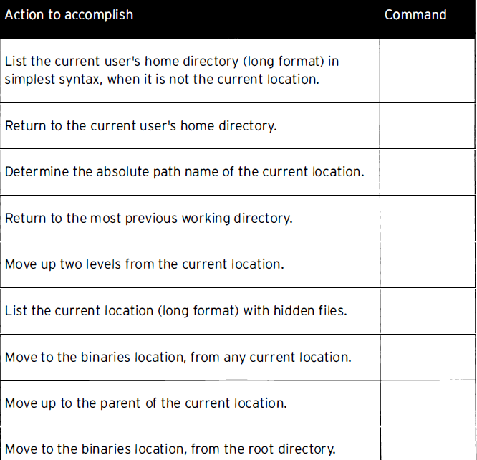
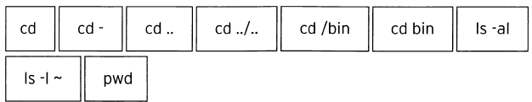
Quiz

Slide 12
Navigating Paths
pwd
ls (a,l,R)
cd
~
touch
. (current directory)
.. (parent directory)
cd – ( alternate between two directories)

Slide 13
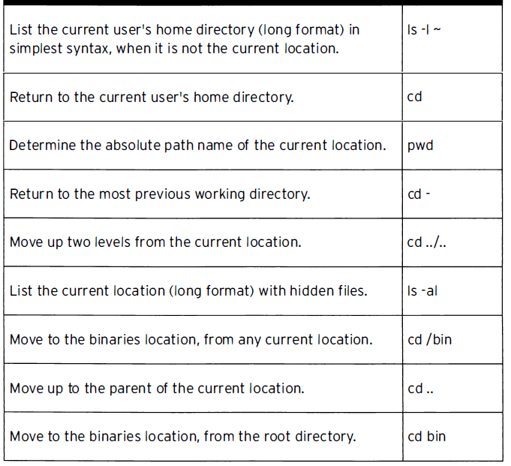

Slide 14
Command line file management
mkdir dir
mkdir -p par1/par2/dir
cp file1 file2
cp file1 file2 file3 dir
mv f1 f2 (renaming in the same dir)
mv f1 /dir/f2
rm (option irf)
rmdir

Slide 15
Task
Create a directory.
Create multiple directories in a single command.
Create a directory when parent dir is missing.
Copy one file to another in the current dir.
Copy multiple file to another dir .
Copy multiple file and dir to another dir.
Rename one file in the same dir.
Move one file to another dir.
Remove an empty dir.
Remove a non empty dir.
Remove a non empty dir forcefully.

Slide 16
File globbing: path name expansion
The Bash shell has a path name-matching capability historically called globbing, abbreviated from the "global command " file path expansion program of early UNIX .
The Bash globbing feature,commonlycalled pattern matching or " wild cards " , makes managing largenumbers of files easier.
Using meta-characters that "expand " to match file and path names.

Slide 17
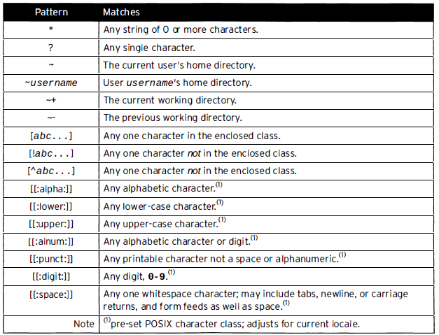

Slide 18
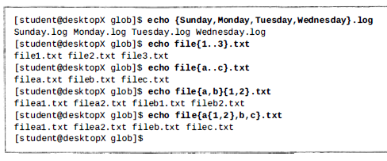
Tilde expansion: The tilde character (~), when followed by a slash delimiter, matches the current user's home directory. When followed by a string of characters up to a slash, it will be interpreted as a username, if one matches.
Brace expansion:

